Slide 1
Instrument virtual de monitorizare a unor parametri din mediul ambiant
Codreanu DAN 6503

Slide 2
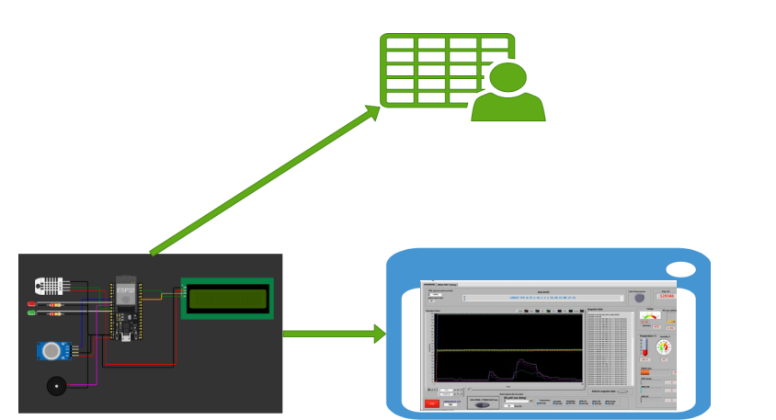
Imagine de ansamblu

Slide 3
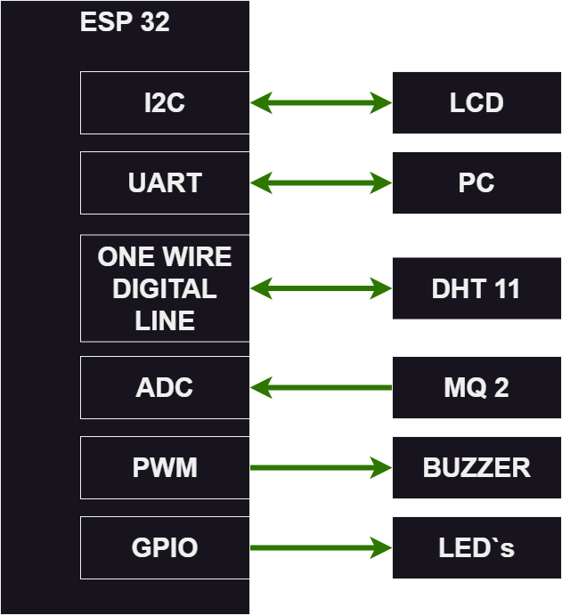
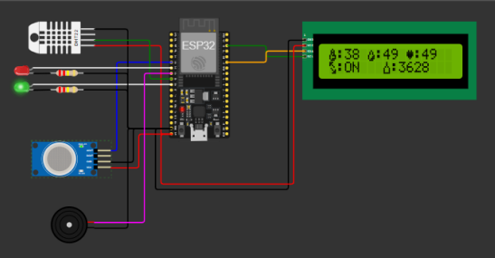
Structura hardware

Slide 4
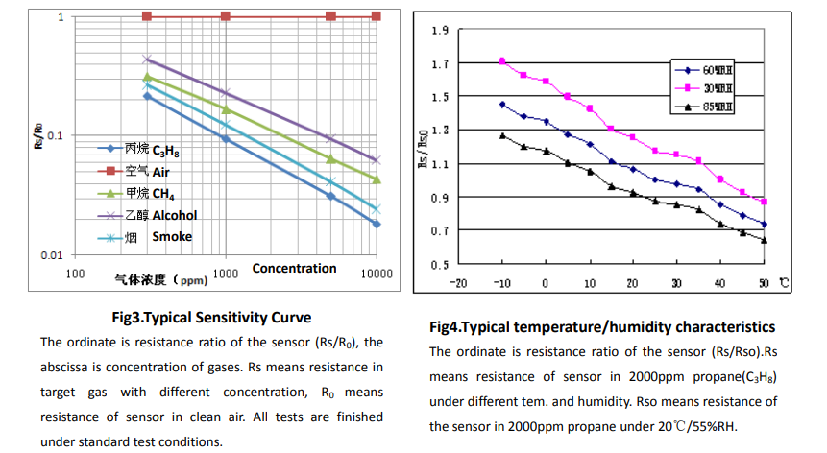
Prelucrare date MQ2
/*
* Two points are taken from the curve. With these two points, a line is formed which is "approximately equivalent" to the original curve.
* data format:{ x, y, slope}; point1: (lg200, 0.21), point2: (lg10000, -0.59)
*/
float LPGCurve[3] = {2.3,0.21,-1.04};
float COCurve[3] = {2.3,0.72,-0.78};
float SmokeCurve[3] = {2.3,0.53,-0.98};
float Ro = 10;

Slide 5
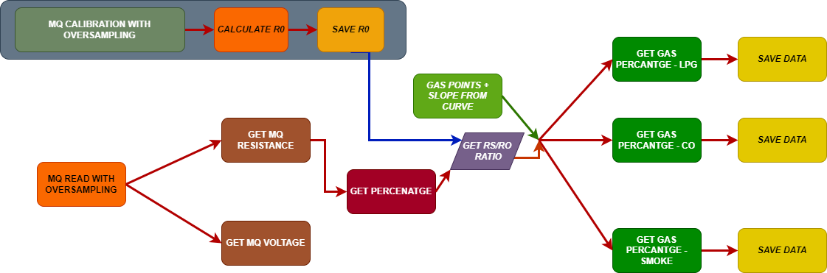
Diagrama pentru calcularea concetratiei de gaze

Slide 6


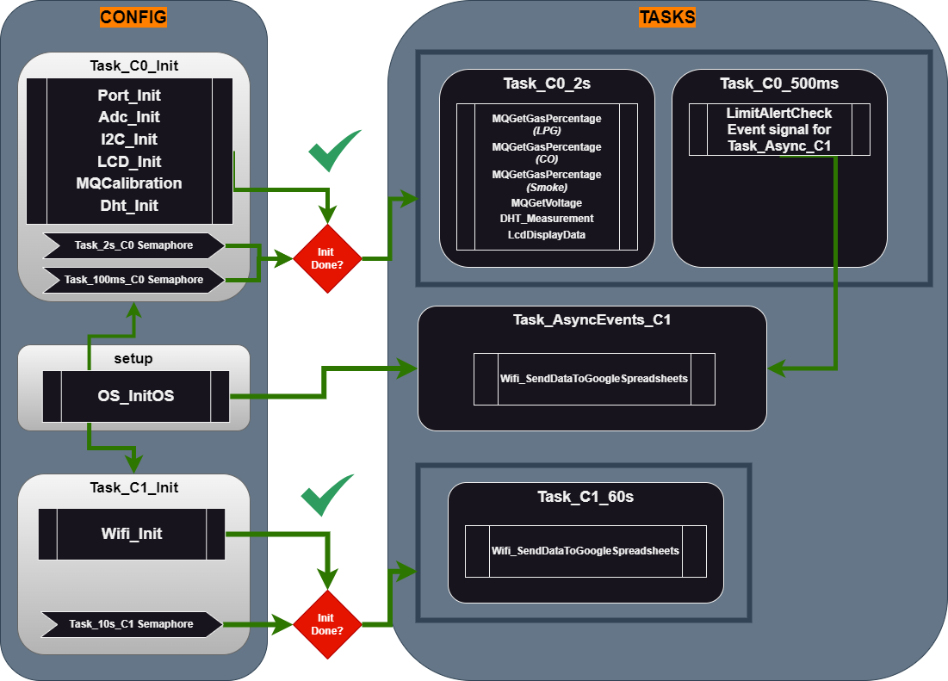



Arhitectura software utilizata

Slide 7
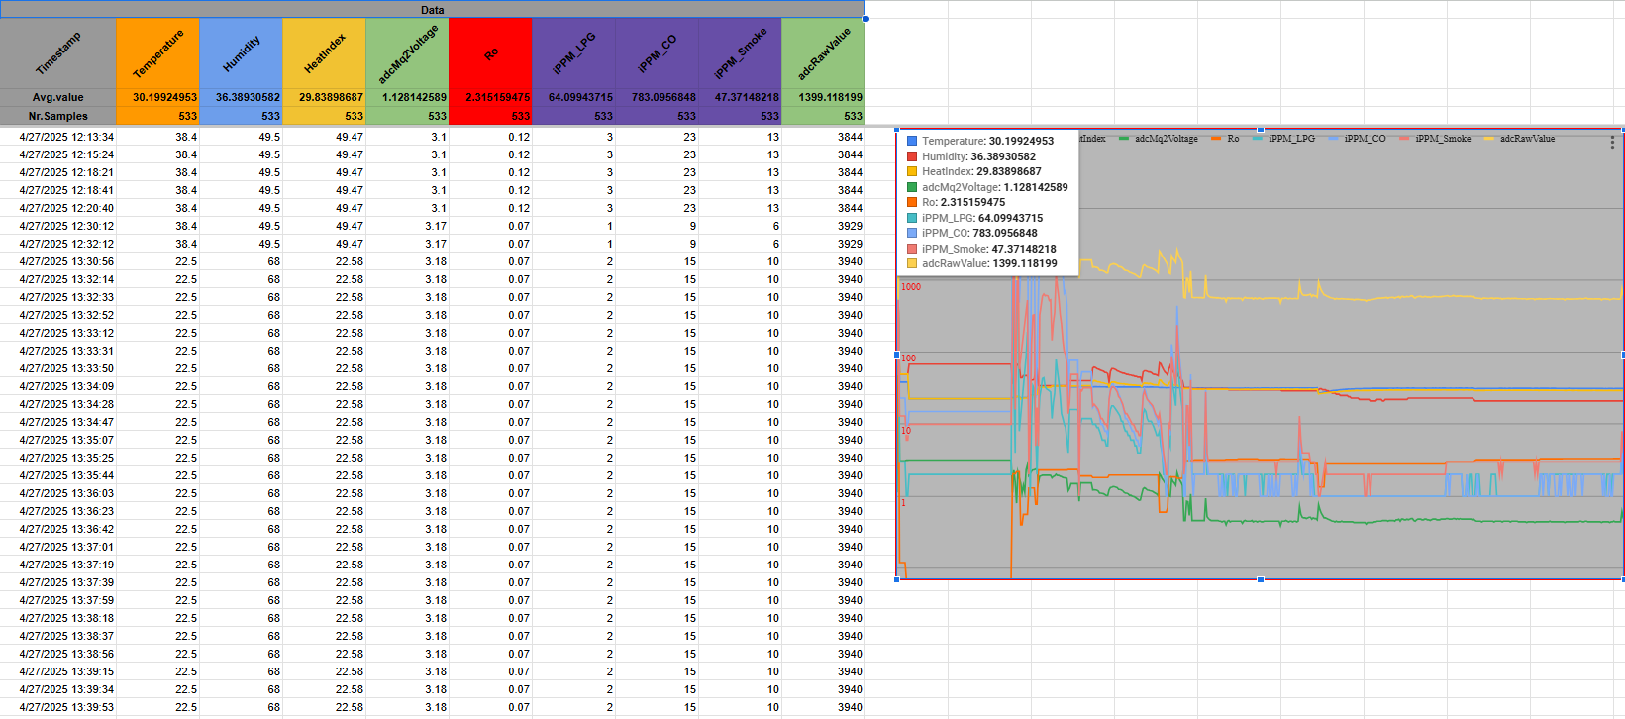
Datele din Google Spreadsheets

Slide 8
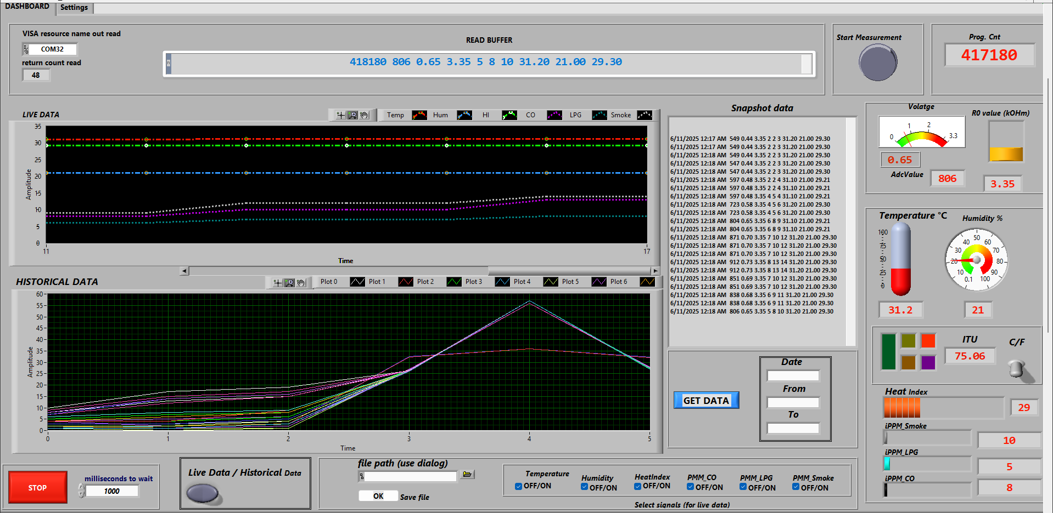
Instrumentul Virtual

